Slide 1
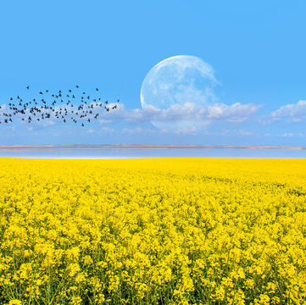
Welcome to My Presentation
Good Afternoon

Slide 2
Basic Information of the Presenter
Name : Yousuf Ali
Department : English
Batch No : 65
Institute : University of Barishal

Slide 3
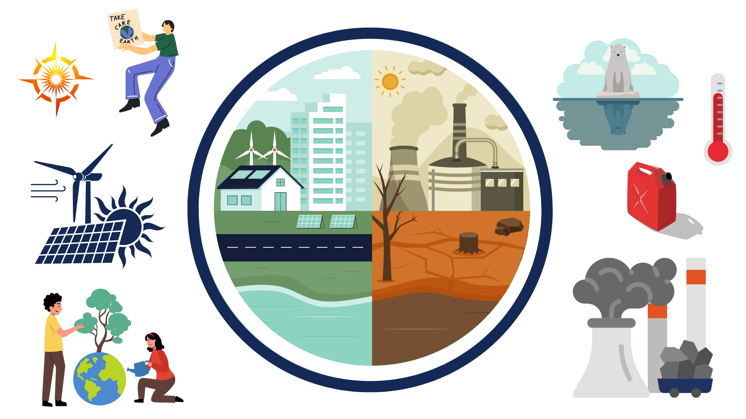
Topic of Presentation Climate Change: Causes, Effects, and Solutions

Slide 4
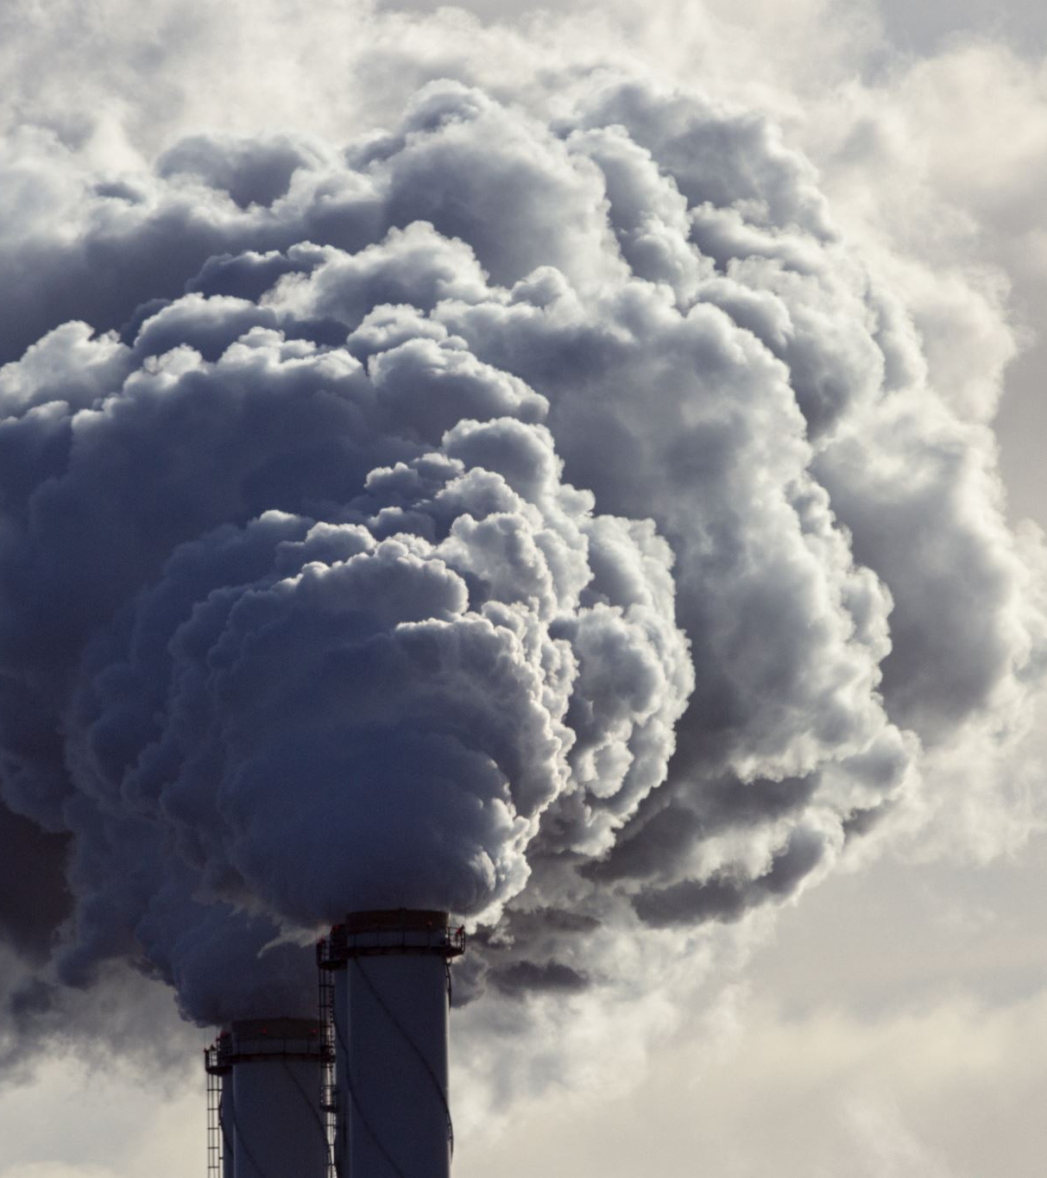
WHAT IS CLIMATE CHANGE?
Climate change refers to significant and lasting changes in the Earth's temperatures and weather patterns.
Since the Industrial Revolution in the 1800s, humans have been the main driver of climate change, primarily due to the burning of fossil fuels like coal, oil, and gas.

Slide 5
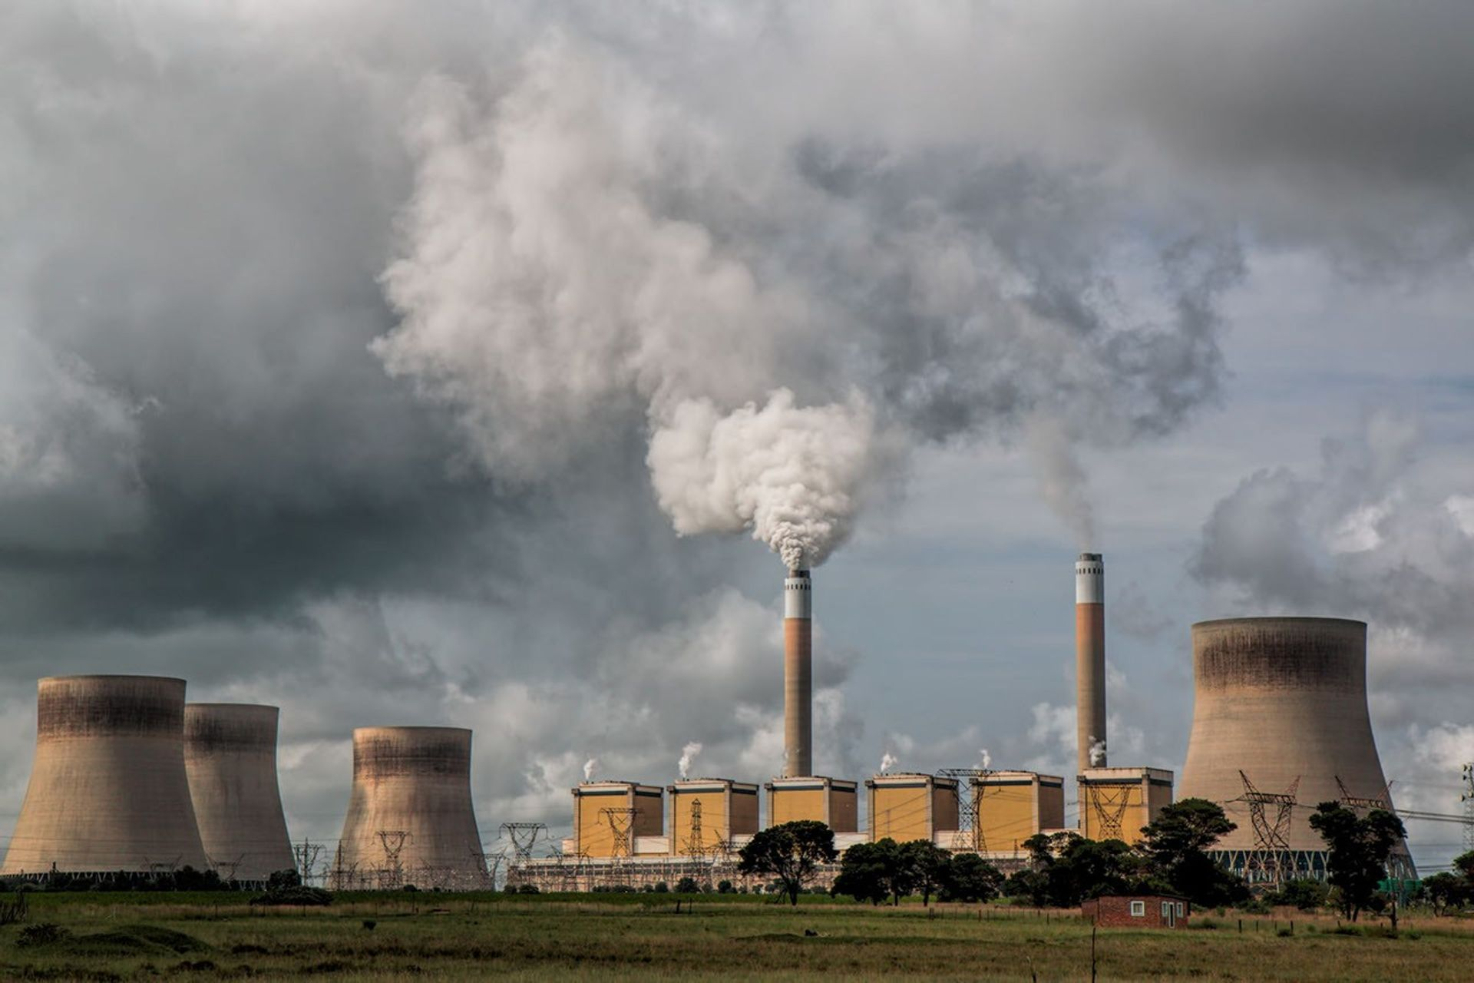
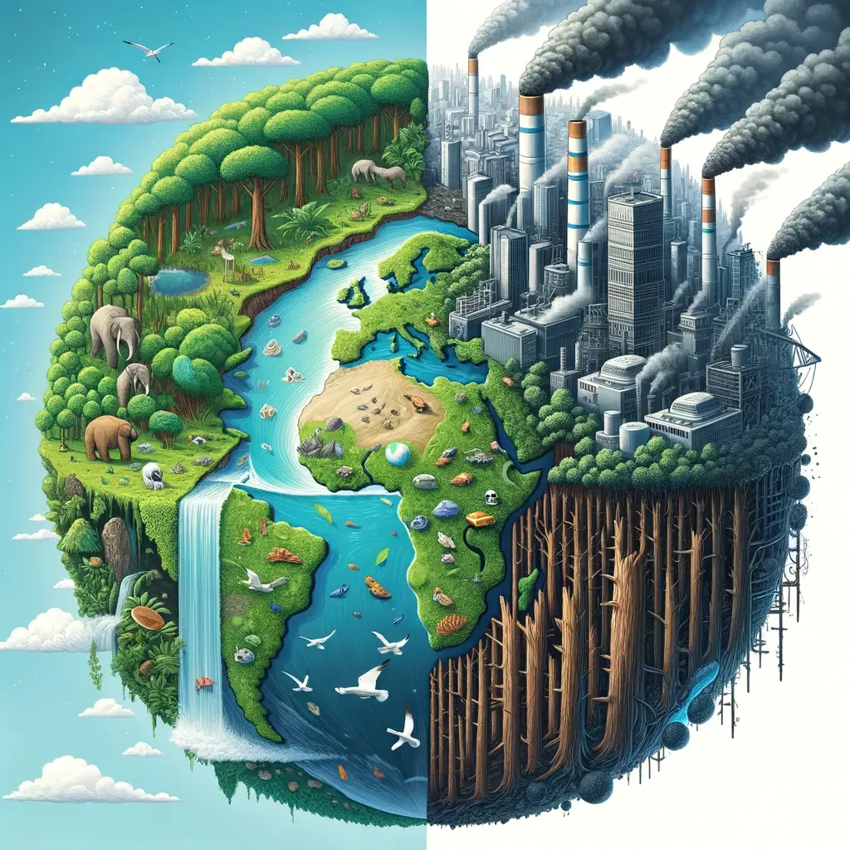
Causes of Climate change

Slide 6
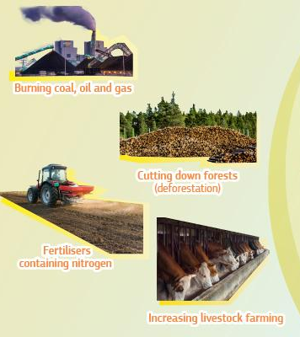
Causes of Climate change
Generating power
Manufacturing goods
Cutting down forests
Using transportation
Fluorinated gases
Fertilisers containing nitrogen
Increasing livestock farming

Slide 7
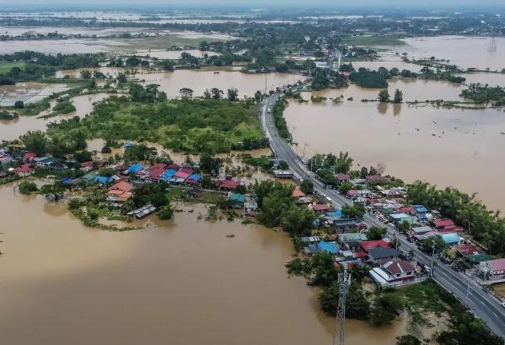
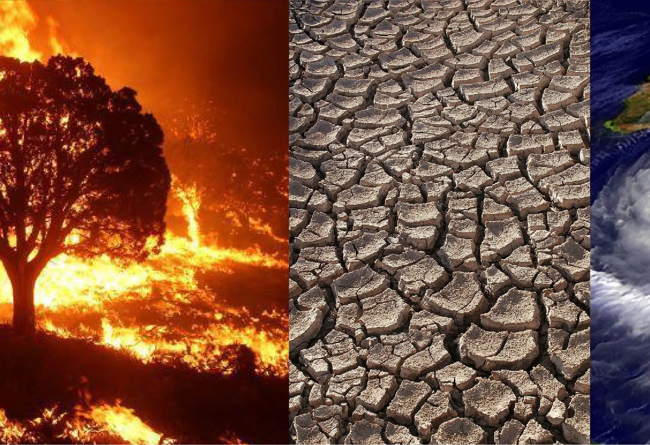
Effects of Climate Change

Slide 8
Effects of Climate Change
Rising Global Temperatures.
Melting Polar Ice and Rising Sea Levels.
Extreme Weather Events.
Biodiversity Loss.

Slide 9
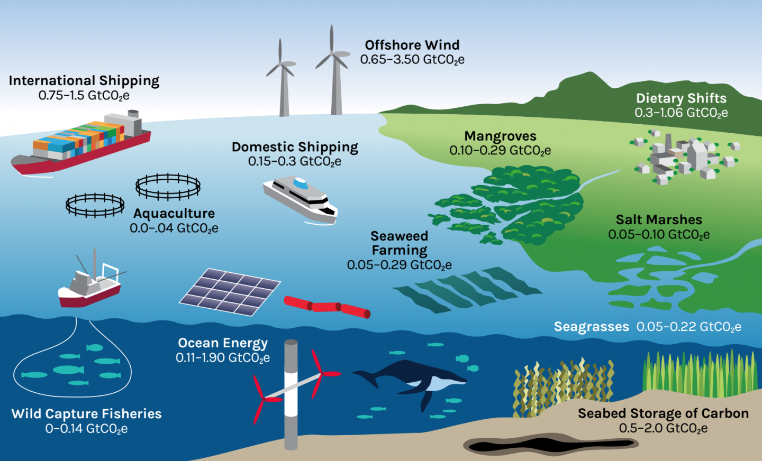
Solutions of Climate Change

Slide 10
Conclusion
Climate change presents an unprecedented challenge, but it also offers an opportunity to build a more sustainable and resilient world. Renewable energy is at the heart of this transformation. Renewable energy is a cause for hope about the future! By embracing clean energy solutions, we can reduce our carbon footprint, protect the environment, and ensure a better future for generations to come.

